Slide 1
INFO6150 32573 Web Design/User Experience Engr SEC 01 Spring 2022
Team members
SHAHLA ZAINAB SHAIK 002194962
SAMEEKSHA GURRALA 002922061
VAISHNAVI SAI CHALLAGULLA 002959612
MEGHANA PALAGANI 002105784
JASPREET KAUR 001529746
JASPREET KAUR BHAMRA 001582619

Slide 2
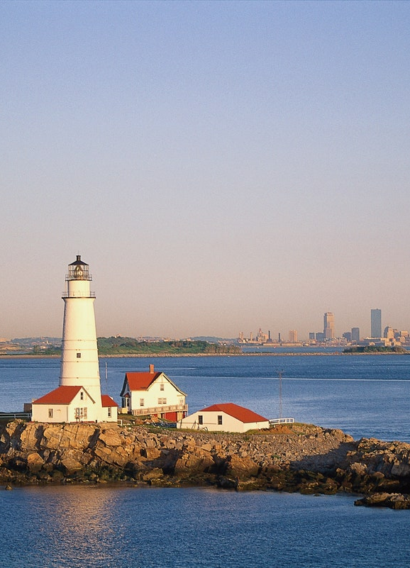
ASSIGNMENT 5B
BOSTON TRAVEL GUIDE

Slide 3
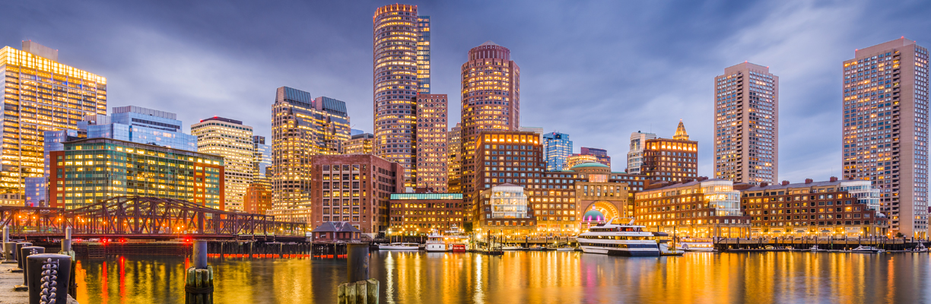
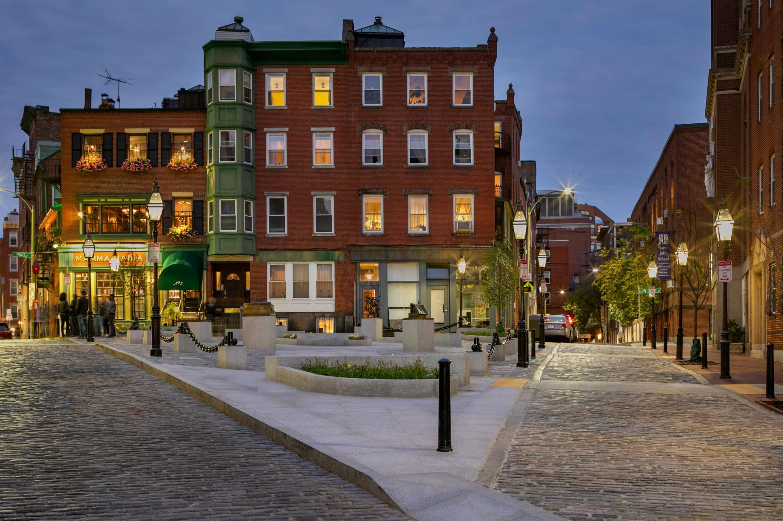
AGENDA
The purpose of the project is to create a website to facilitate user to explore Boston city better and help the user travel comfortably by providing the reliable services in affordable packages under one roof.
The website created is user friendly and helps the traveler to access website regardless of screen dimensions.

Slide 4
overview
The work done so far includes:
A landing page is created for Boston Travel Website.
HTML, CSS are primary web design tools used in this project.
Bootstrap framework is used for further customization.

Slide 5
CONTENT
The first page of the website takes the user to the landing screen of Boston Travel Guide. Landing page consist of Log In screen where user can create his account to log in to the portal.
Basic overview of the packages for different popular visiting spots is displayed.
For queries and quick responses, the application also provides the user to send the message under Contact section.

Slide 6
BOOTSTRAP 5 Components
Side Navigation Bar
Dropdown
Carousel
Filter
Logos
Button
Card

Slide 7
BOOTSTRAP 5 Components
Image
Well In (Contacts)
Inline List (Header)
Forms
Model Plugin (Login)
Scroll Spy
Grid System(Headings)

Slide 8
FURTHER IMPLEMENTATION
As of now, our team has designed the landing page using different UI components.
Next step would be – Improvising the frontend by making the web page more responsive and interactive by implementing the backend.
Express JS, NodeJS and Mongo DB is planned to be implemented for the backend.

